Slide 1
Control of Invasive Weeds in Green Stormwater Infrastructure Systems
Prepared by Lia Mastropolo, AKRF
Notes:
Welcome to this Green Infrastructure Maintenance Training. This presentation is one of several in the training series.
You can view the entire series sequentially or each module independently.

Slide 2
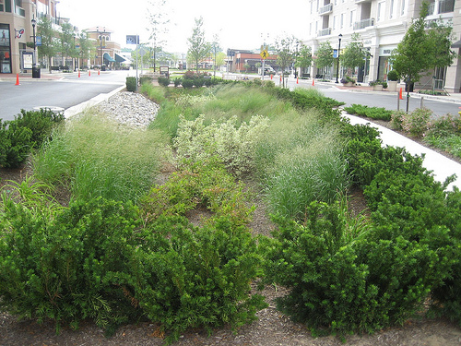
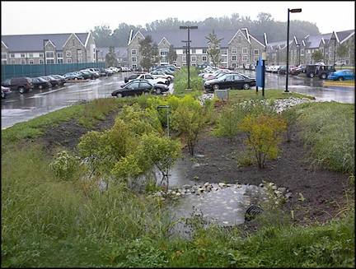
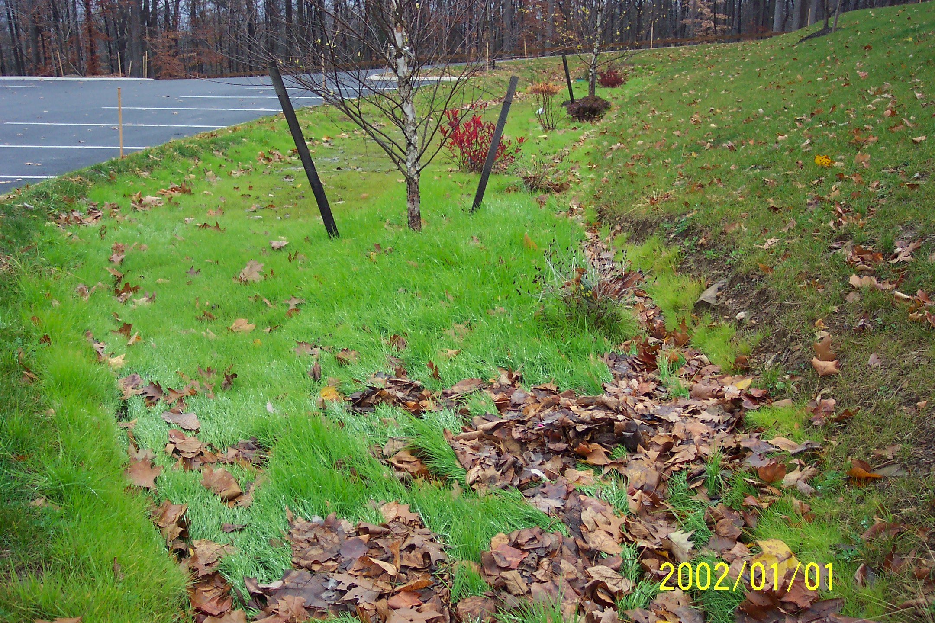
Overview
Why is it important to control invasive weeds in green stormwater infrastructure practices?
What are the characteristics of invasive weeds?
How do we identify common invasive weeds?
What are best practices for invasive weed removal?
Notes:
The plants used in Green Infrastructure are carefully chosen to keep the system working properly. In this session you will learn:
Why it’s important to control invasive weeds in green stormwater infrastructure practices;
Characteristics of invasive weeds;
How to identify common invasive weeds; and
Best practices for invasive weed removal.

Slide 3
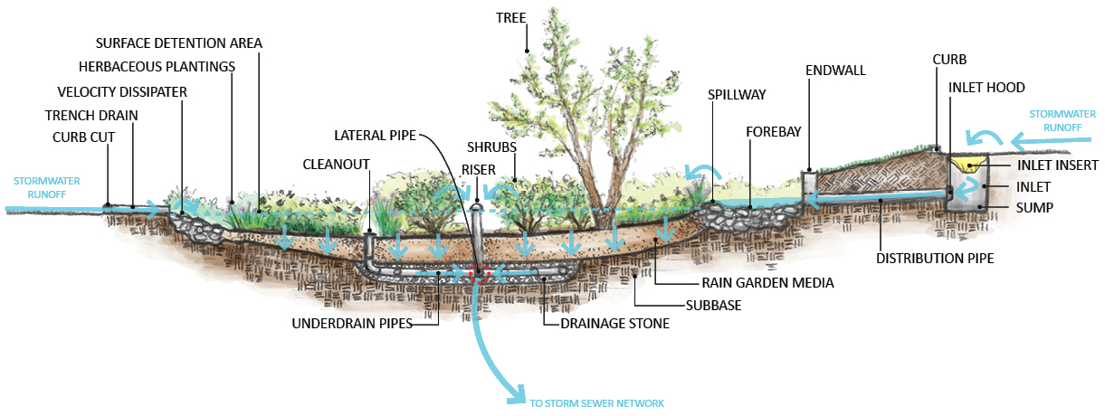
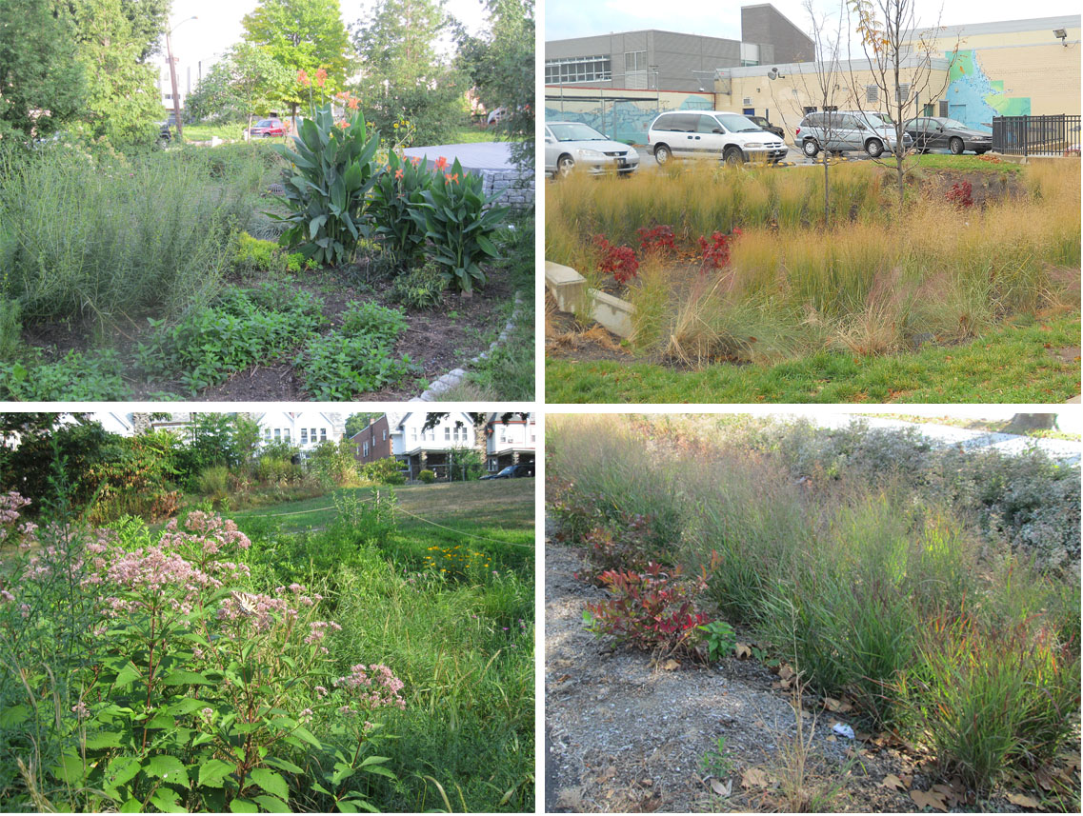
Green Infrastructure Function
Notes:
To understand why weeding is necessary, it’s important to understand how green infrastructure works. This photo shows a cross section of a bio-retention system or rain garden, with water moving into the system through an inlet. Water in the rain garden may infiltrate into the soil, or it may be evapotranspired by plants. These processes are important because they reduce the amount of stormwater that’s released from the rain garden.
The plants in a rain garden can be an important source of habitat to insects and birds. Deeply rooted plants help keep the soil loose and can improve infiltration. Plants are also very important for keeping up the appearance of the rain garden.
After a rain garden is planted, the plants will likely grow and spread over time. New plants may be introduced to the system and other plants may die out. This is part of the natural process of establishment.

Slide 4
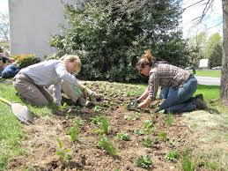
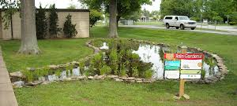
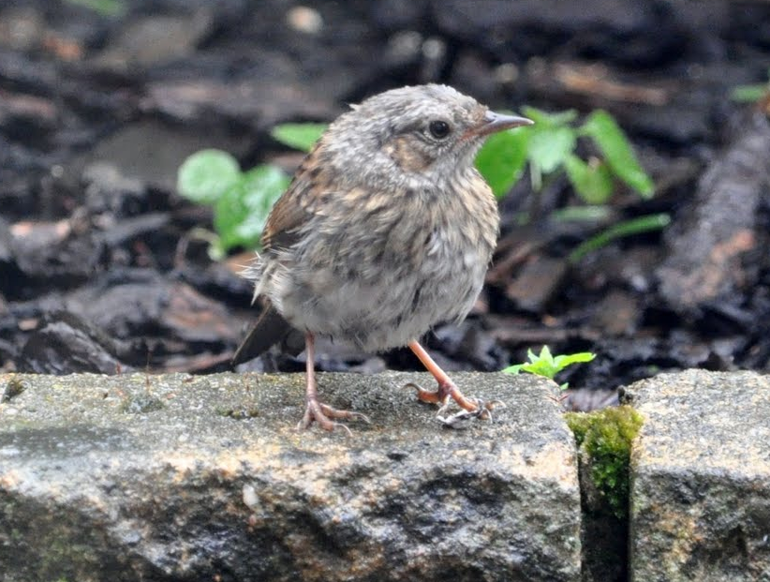
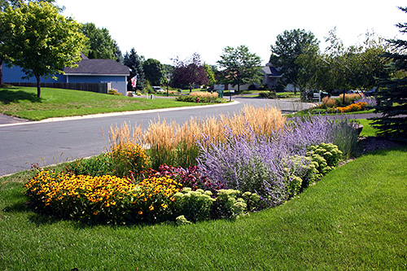
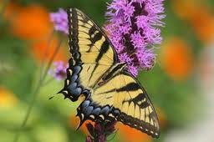
What Happens After Planting
Small plants are spaced throughout the garden.
Open areas are left for the plants to grow into.
It rains; stormwater fills the garden.
Seeds, plant parts and other plant material enter the garden along with stormwater
Plants start to grow and get bigger
Animals start to visit the garden, and add seeds to the garden
Notes:
Small plants called plugs are usually the first plants installed in the bed of a green infrastructure system. They are planted far enough apart that they will have space to grow and expand to fill in the garden over time.
Over time as water collects in the system, other materials are carried into the planting bed, including seeds.
As the plants grow, wildlife start spending time in the garden, leaving plant seeds that stick onto animal fur and via bird droppings. Seeds can also blow in from nearby areas. In time there may be a mix of different plants growing in the system that were not originally planted.

Slide 5
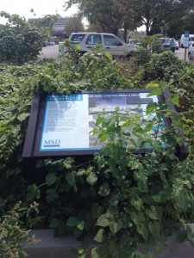
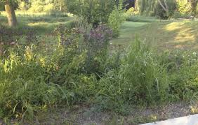
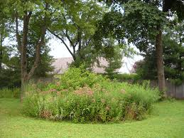
Here Come the Weeds….
Decisions to be made:
  How do I want this garden to look: prim and neat or natural and wild?
  Are there plants in there that could impact streams, rivers or woods near by?
  How much maintenance to I want to do to keep this garden exactly the same as it was designed?
Notes:
Some of the seeds that are carried into the rain garden may be seeds that should be allowed to grow and spread. Other seeds may be weed seeds. A plant that’s considered a weed in some settings may not be considered a weed in other settings.
Management decisions must be made by the owner, depending on how they would like their system to ultimately look. Plants grow, spread, die back and new ones are frequently added to gardens. The owner must decide how close to the original design they would like to keep the garden.
It’s important to remember that green infrastructure, unlike most landscaping, is designed to perform a specific function. It is a priority that these systems do their job of infiltrating and evapotranspirating stormwater, which means they need to maintain good plant cover with deep roots that keep soil porous.
Some systems located at highly visible areas may require more plant maintenance than those within natural landscapes in a park. Some areas in parks and natural settings may not need to be weeded all that frequently, whereas areas with a lot of nearby foot traffic may need to be more carefully weeded and landscaped. All systems should be monitored for aggressive or invasive plants that will impact other natural systems.
The maintenance crew may need to determine how the presence of new plants could impact the sustainability of the original plant community designed for the garden.

Slide 6
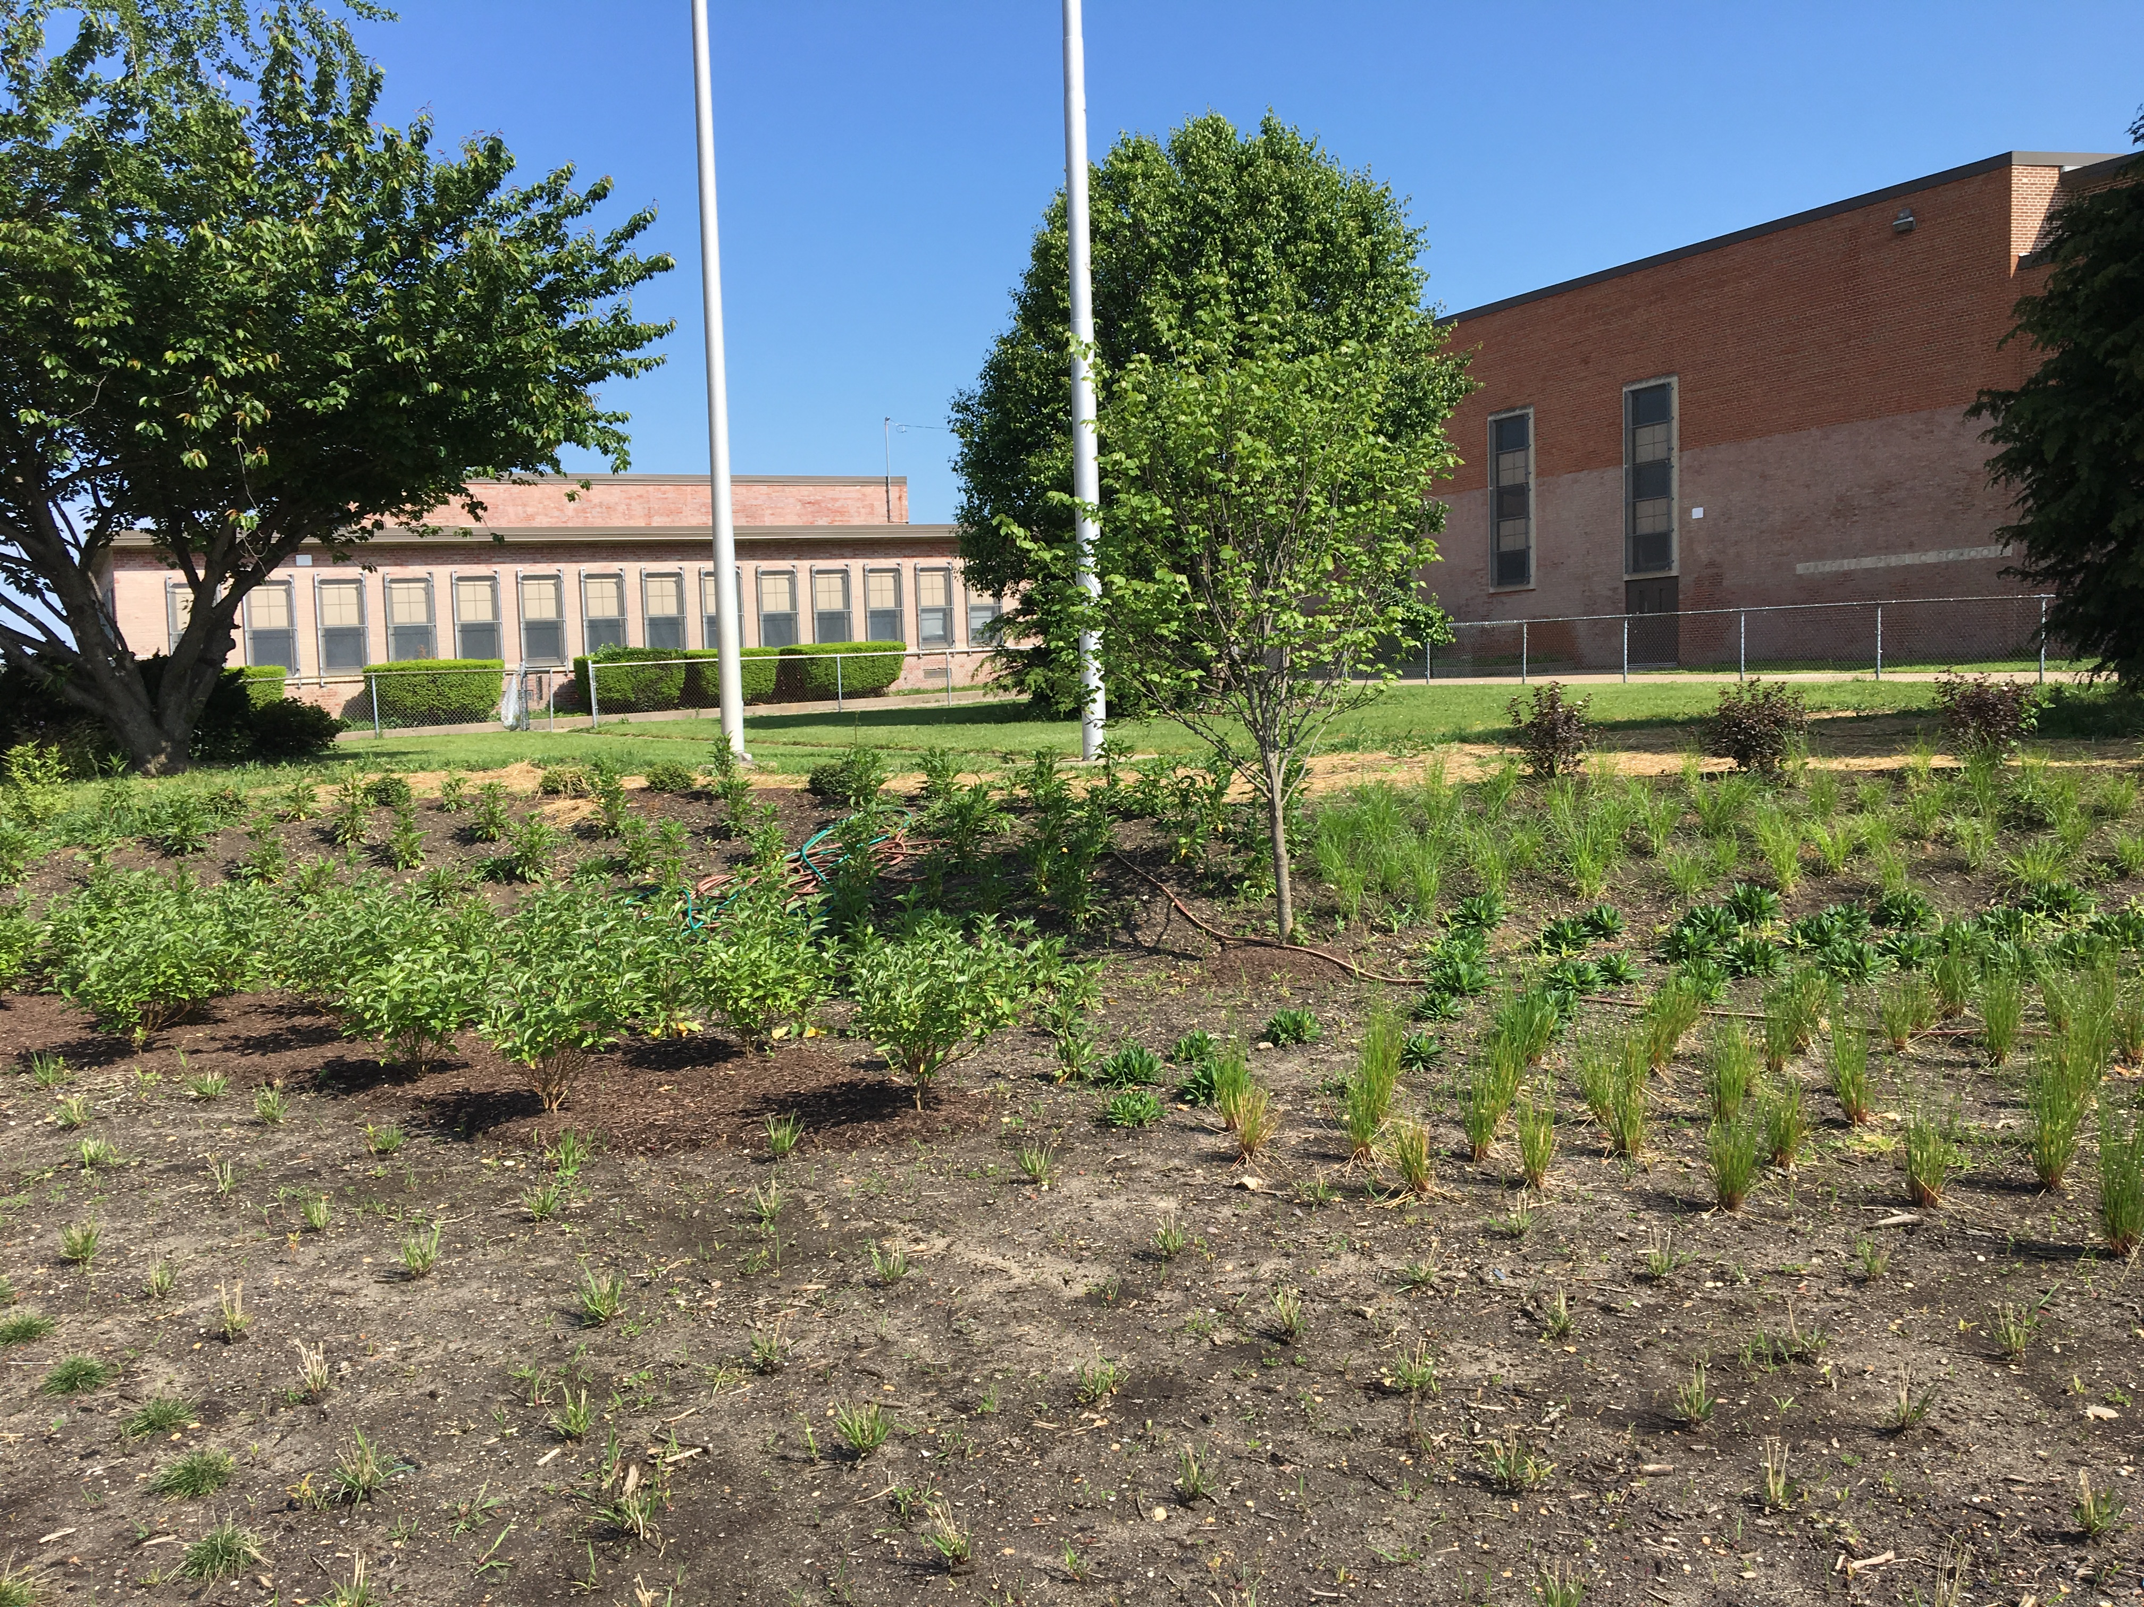
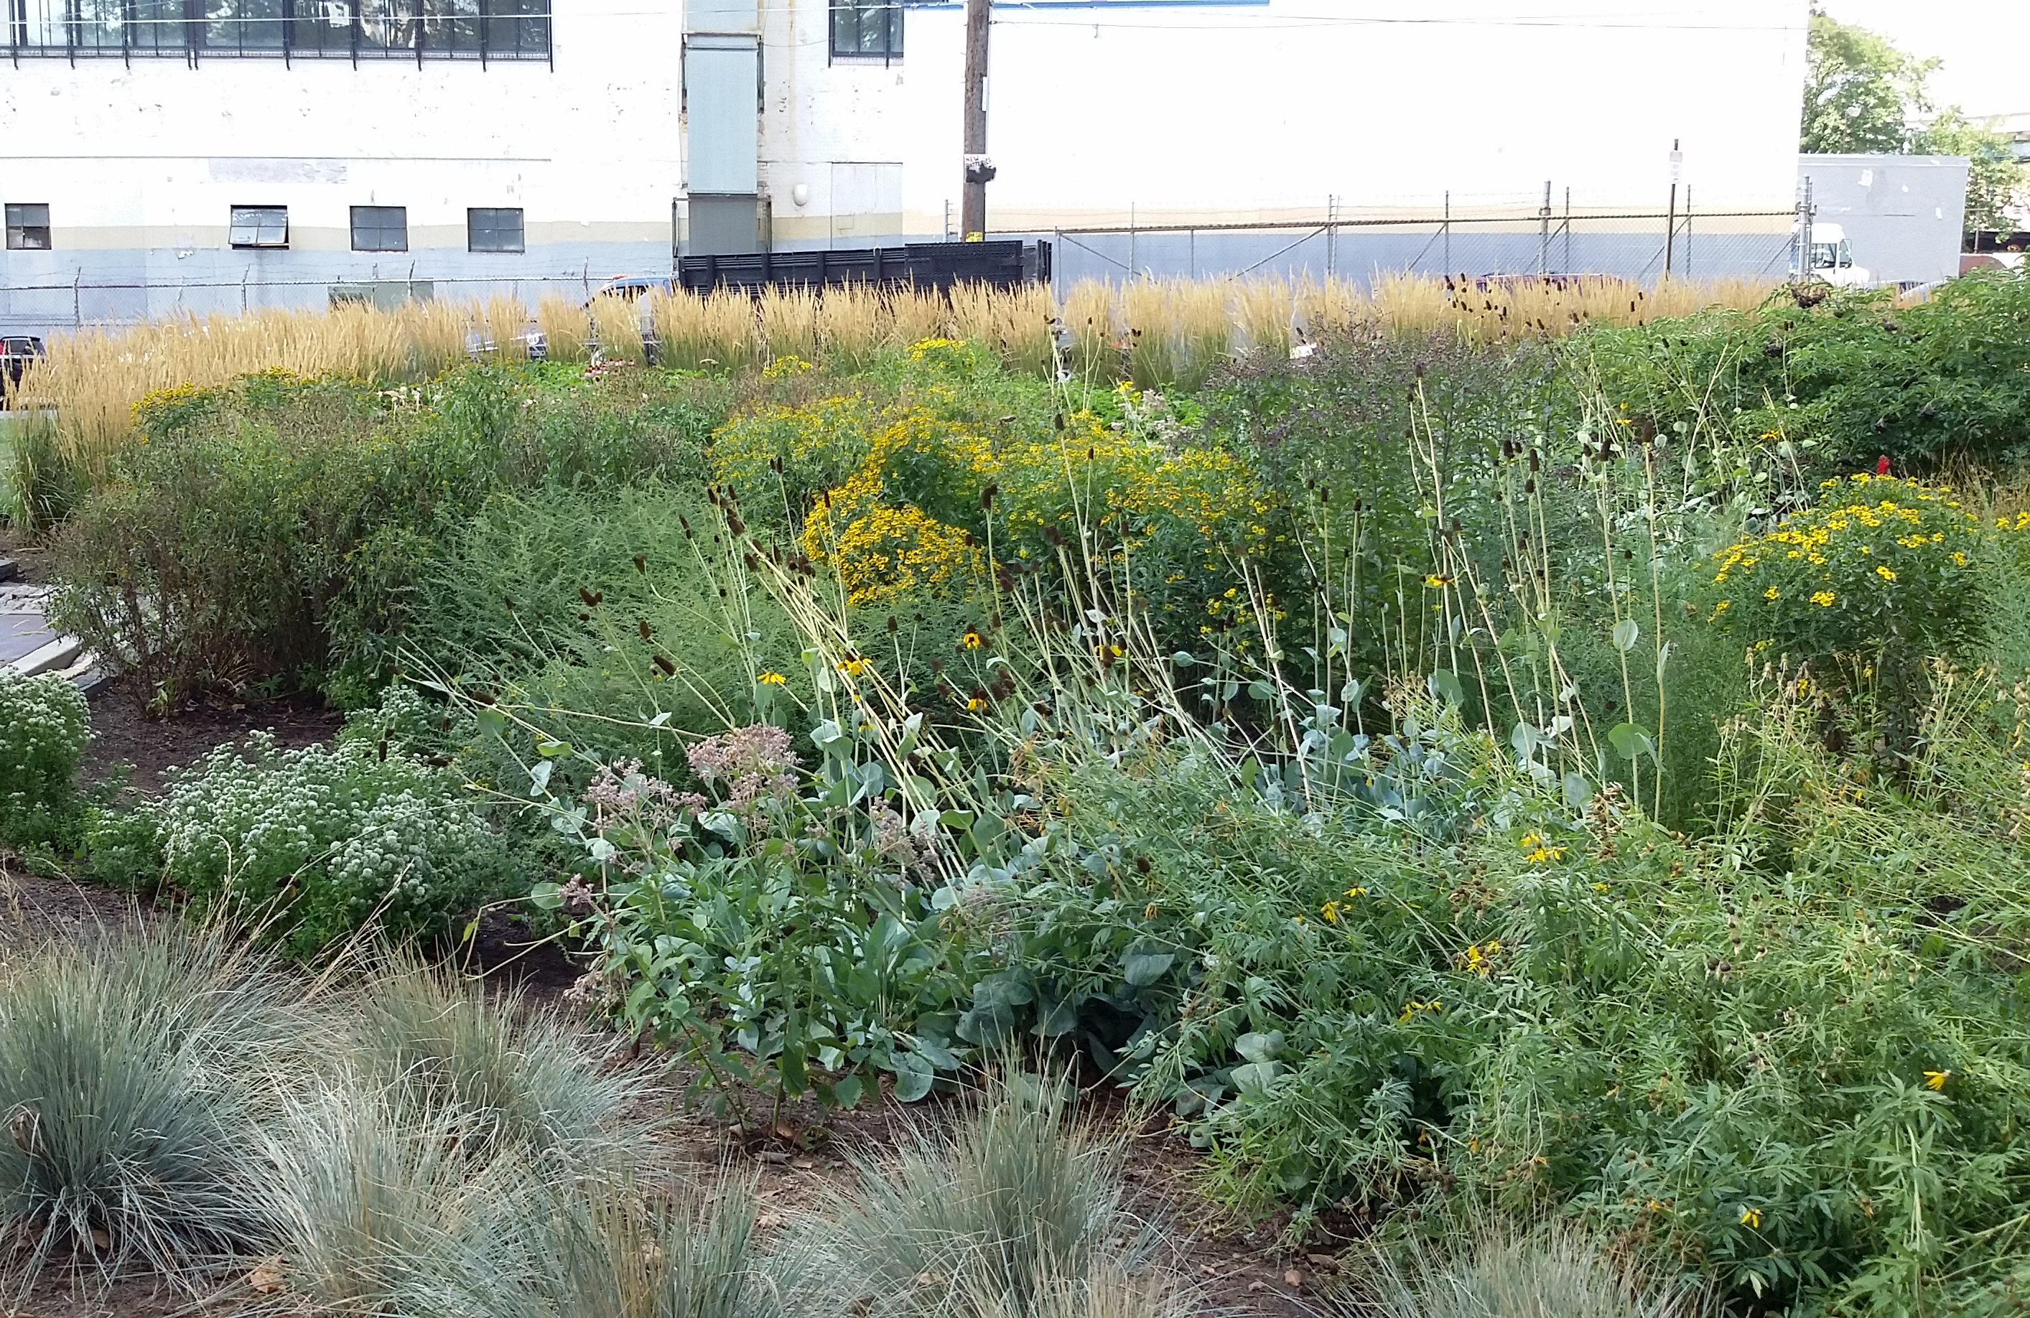
Pre- and Post-Establishment
Establishment
  Bare soil gives a large area for non-target vegetation to grow
  More challenging to control
Post-Establishment
  Smaller area for non-target vegetation to grow
  Less challenging to control
  Non-target vegetation can be challenging to find/identify once target vegetation has established
Notes:
Weeds may need to be managed differently early in the life of a green infrastructure system versus after the target plant community has established.
When plants are first installed they are usually spaced far apart--sometimes as much as several feet, which creates large, bare soil/mulched areas where weeds can grow aggressively. These areas need to remain weed-free in order to allow the target plants to spread.
With proper weeding and care, target vegetation will eventually fill in bare areas and make it more difficult for weeds to enter. At this point, weeding frequencies can be decreased.

Slide 7
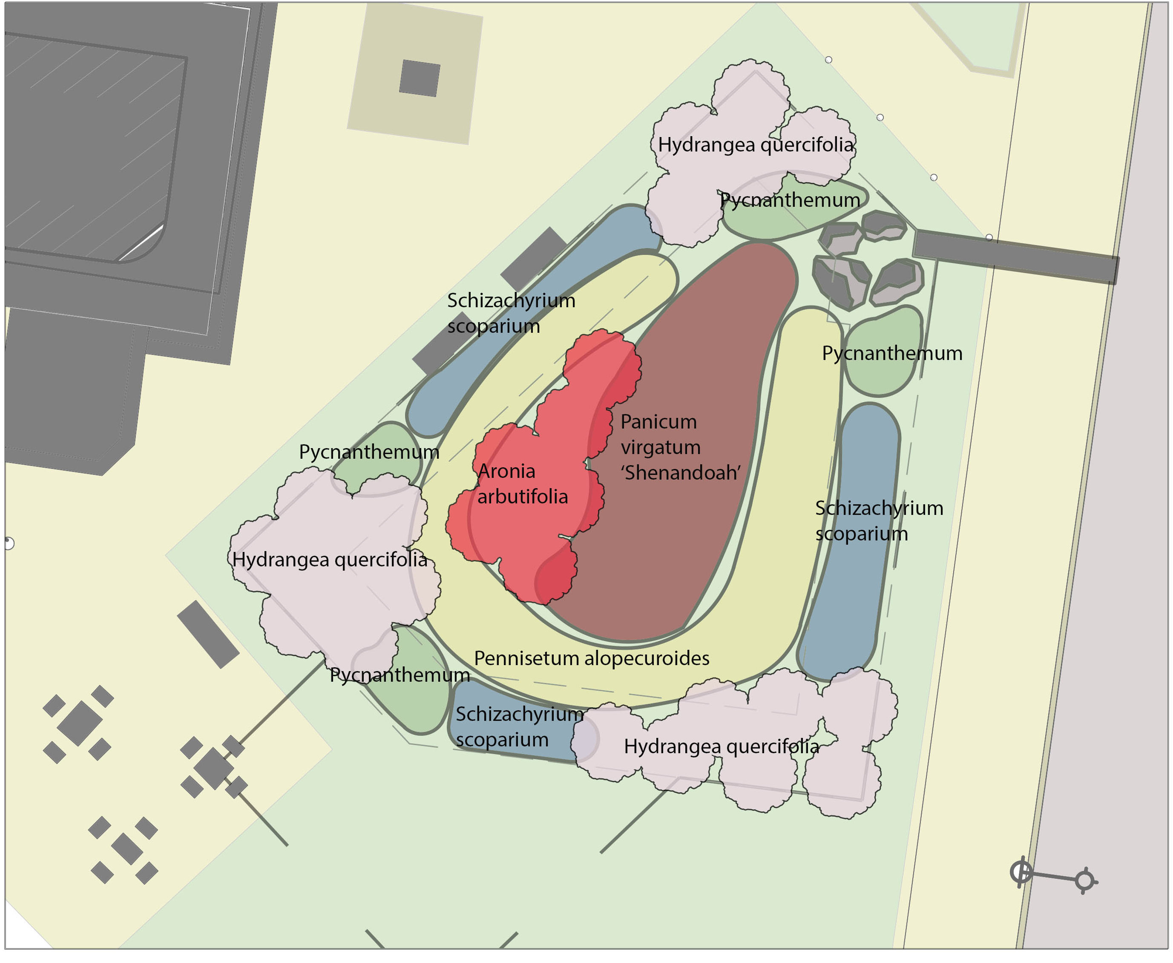
What Do We Plant in a Rain Garden?
Notes:
For maintenance crews, it may at first be difficult to identify which plants are weeds and which are not.
In some cases, the owner may have a planting plan with a list of species that should be in the green infrastructure system. But more often, the system will have changed naturally since it was planted, or the owner may have added or removed plants.
The following are some common characteristics that identify plants that might be selected for a green infrastructure system.

Slide 8
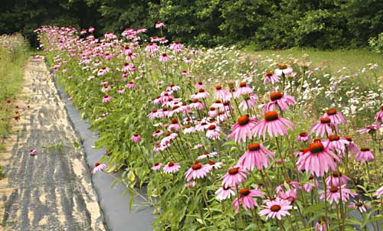
Perennial Plants
Plant will live for many years.
Top portion of the plant dies off in the winter, but root system stays alive.
Plant gets bigger every year.
May spread by seed or rhizome
Notes:
Bio-retention plants are typically perennials. Perennial plants come back every year, even after winter die-back. This kind of plant usually continues to spread over its lifetime, by seeds and/or underground root-like systems called rhizomes. Perennials are good for green infrastructure because they are usually fairly low maintenance and don’t need to be replanted at the beginning of each season. In some cases, they may even grow too densely and need to be thinned.

Slide 9
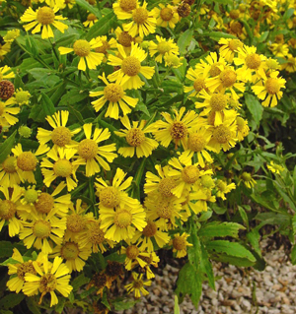
Perennials:
Tolerant to Both Drought and Wet
Once established, can handle extended periods of time without water but can also take occasional inundation (soils are saturated after a rain event).
Notes:
Bio-retention plants are tolerant to both drought and wet soils. This is especially important in urban gardens with sandy soils where the water will pass through quickly, leaving dry conditions for most of the time.

Slide 10
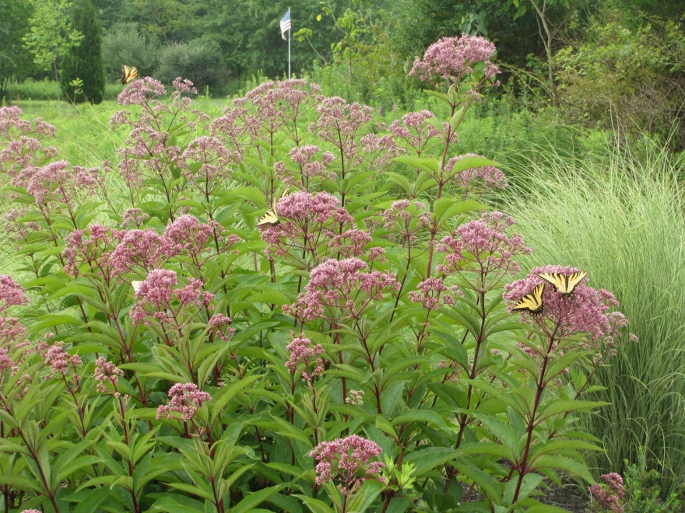
Perennials –
Height Taller than the Depth of Ponding
Plant is rigid and upright.
Doesn’t require staking to stand up.
The majority of the plant is taller than the depth of stormwater that will pond in the garden.
Notes:
These plants are usually taller than the ponding depth of the planting bed. Thus they will not become completely submerged during an extended rain event.

Slide 11
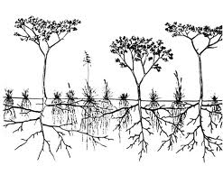
Perennials -- Deep Rooted
Perennial plants have dense deep roots that penetrate deep into the soil to guide stormwater down into the ground.
Notes:
The plants typically have deep roots that keep the soils loose to help direct the stormwater into the ground, deep into the soil.

Slide 12
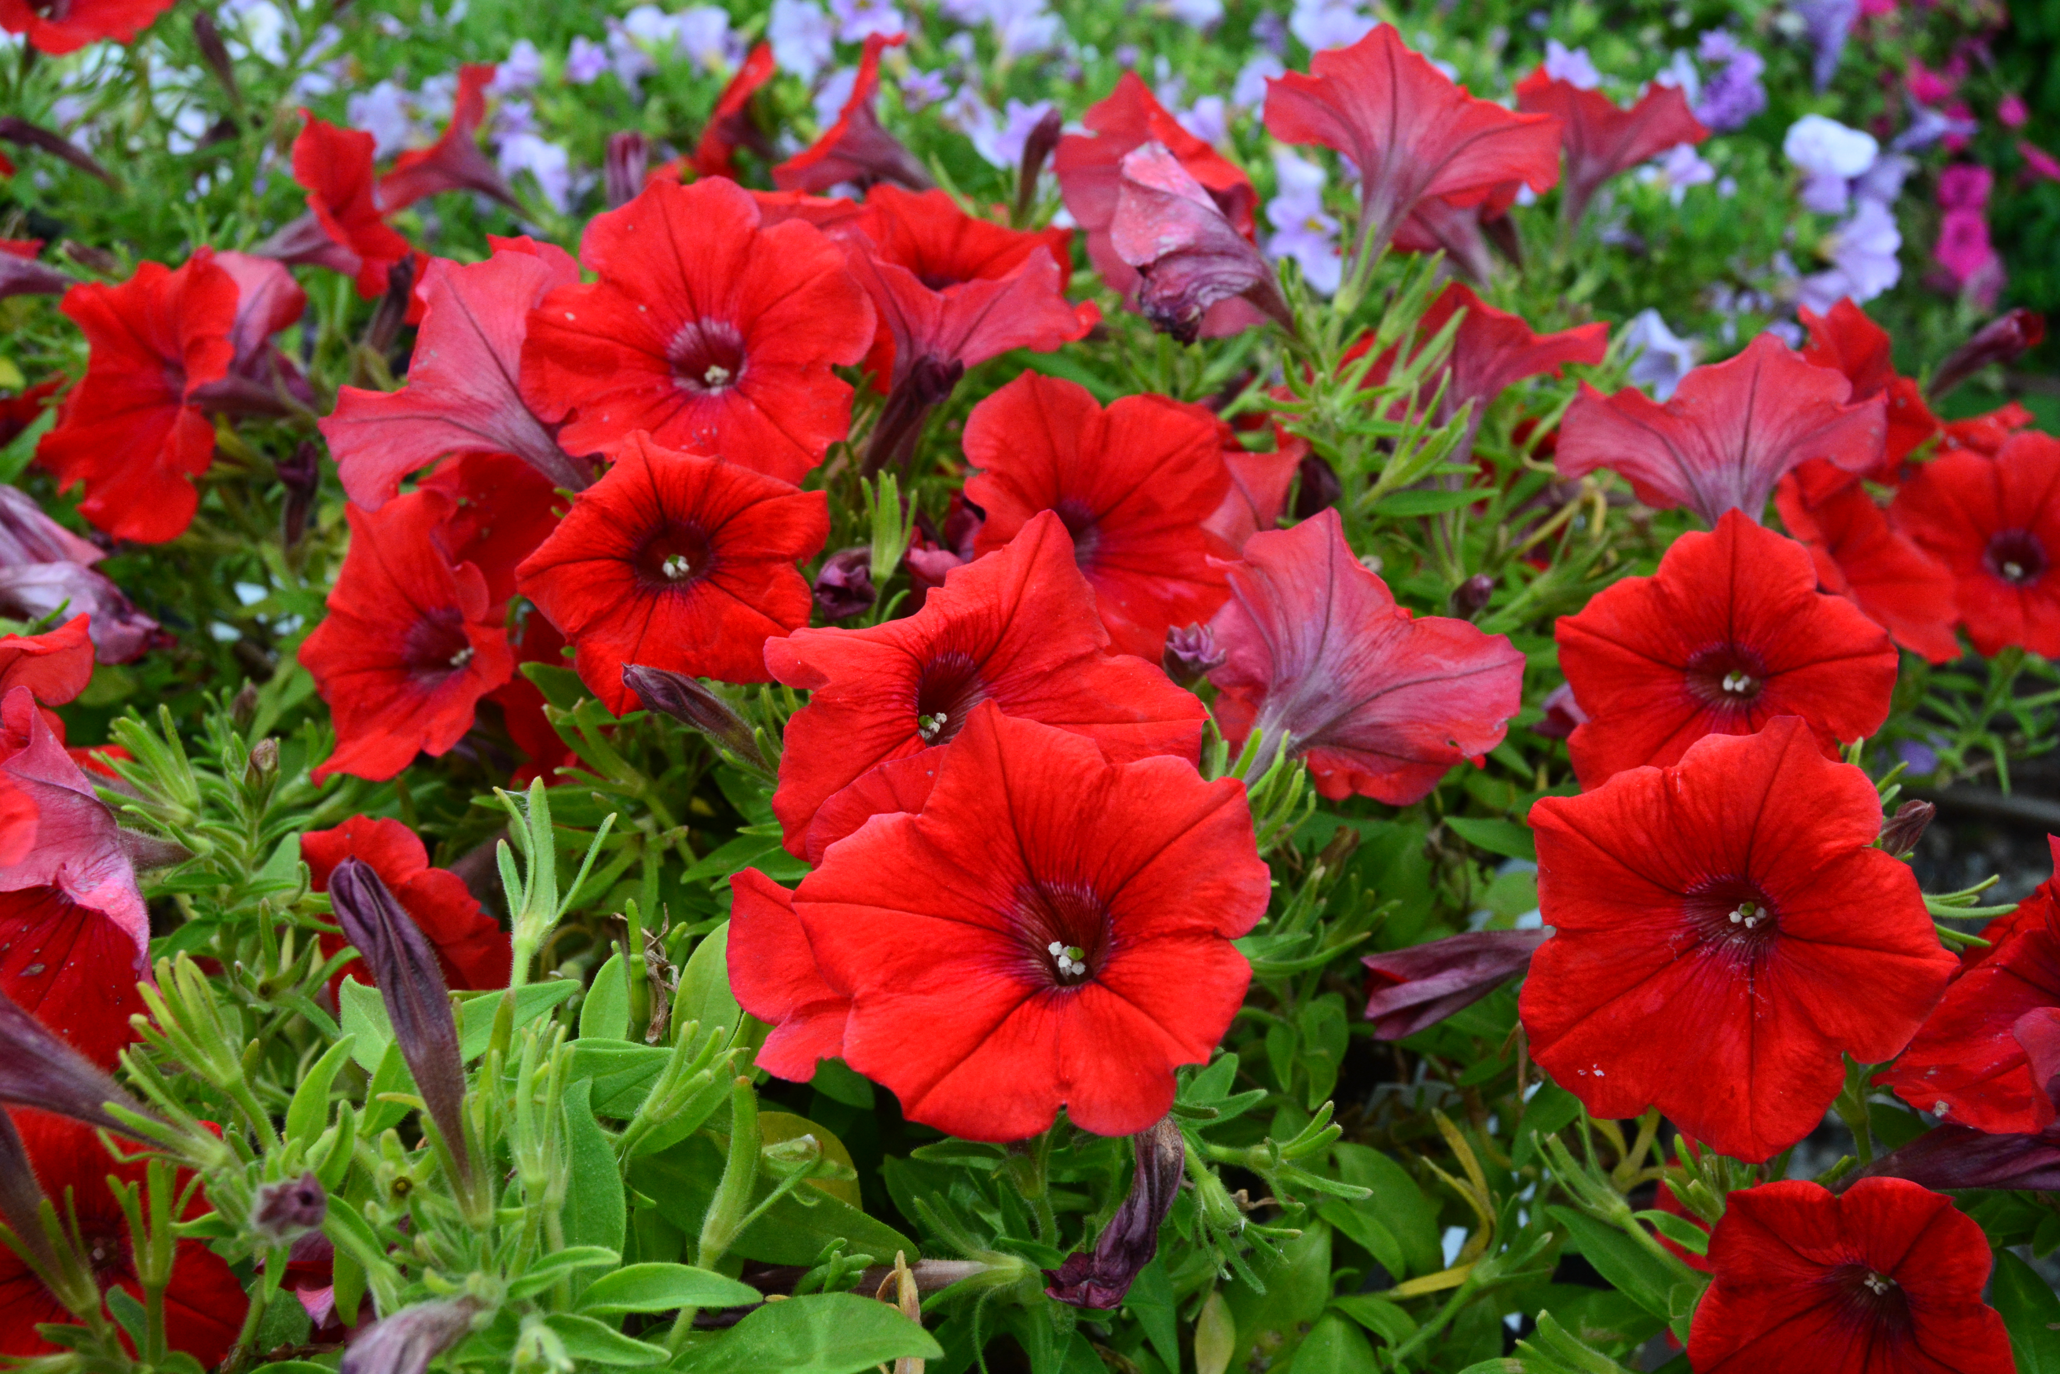
Annual Plants
Plants that perform their entire life cycle from seed to flower in a single growing season.
All roots, stems and leaves of the plant die annually.
Dormant seeds bridge the gap between one generation and the next.
Notes:
Annual plants, unlike perennials, die back at the end of each growing season and don’t come back from the same root system in the spring. Annuals may drop seeds at the end of the growing season, which may grow into a new plant in the spring. Annuals typically do not have the same deep root systems as perennials, since these plants only have one season to fully develop.
When dealing with weeds, it’s important to know which are annuals and which are perennials, since this can have an impact on how you manage them.

Slide 13
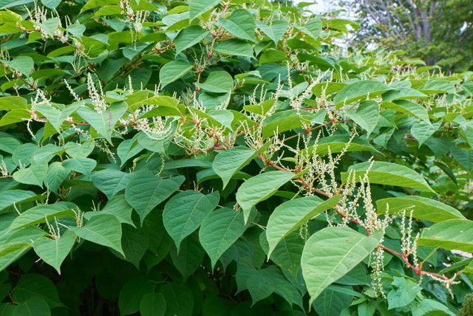
Non-Native Invasive Plants
Introduced from outside the ecosystem with characteristics that allow them to dominate and limit diversity
Outcompete native plants for light, space and nutrients
Offer little to no benefit to animal and insects within that ecosystem
Notes:
Weeds can generally be grouped into two categories: those that are unwanted for aesthetic reasons, and those that are unwanted because they are invasive and harmful to the environment.
Invasive weeds are plants that are not native to their local ecosystem. They are prolific reproducers, have fewer predators or are less sensitive to local weather stress, and so can completely take over an area, shading out and killing the other plants nearby. This creates poor habitat and reduces species diversity.
When maintaining a green infrastructure system, it’s important to monitor any new plants that were not originally planted. If invasive plants are found, they need to be removed immediately to prevent them from spreading within the garden or into the surrounding landscape and natural areas.

Slide 14
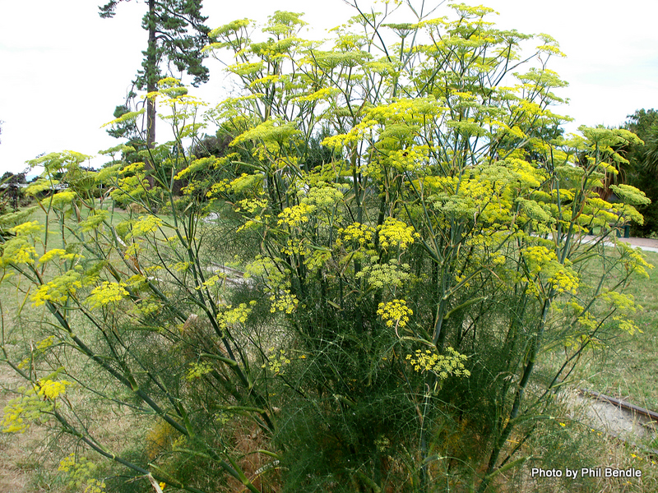
Weeds
Not planted by the gardener
Not valued where they are growing
Vigorous growth which can choke out more desirable plants
Can indicate poor soil conditions
Notes:
There are also many plants that are considered weeds that are not invasive. These may just be plants with an untidy or unappealing growth pattern, or plants that are too tall or too short for their setting. Some native plants that are not necessarily harmful from an ecological perspective may be very aggressive growers that could still crowd out a landscaped area if they’re not controlled.

Slide 15
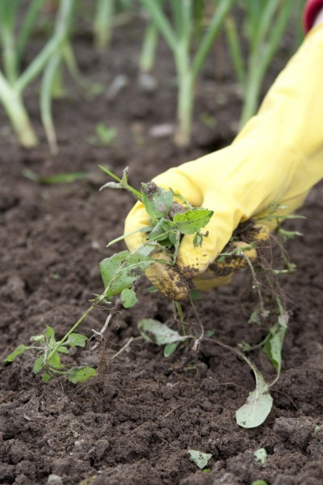
Weed Management
Understand plant biology
Manual removal methods
Do not apply herbicides
  Must be a PA licensed pesticide applicator
  Herbicide will easily move into groundwater
  Strategic & targeted application when necessary
Alert supervisor
Notes:
There are a number of different methods to remove weeds, including hand weeding or applying herbicide. It’s important to understand the biology of each plant you want to remove in order to choose the best weed removal technique. If the wrong method is used, it could actually cause the weed to increase in number rather than decrease.
If in doubt about a plant or it’s treatment, notify a supervisor or someone familiar with the species and its removal.

Slide 16
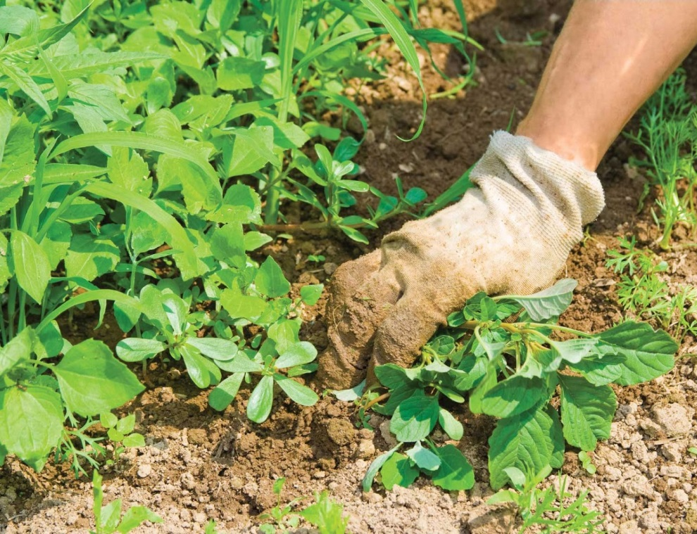
Hand Pulling
Gather plant near the base and pull upward (remove entire root mass including tap root)
Use a shovel or spade if it helps loosen the soil
Easiest when soil is moist
Using a shovel or rake smooth the soil to fill in the remaining hole and cover with mulch
Properly dispose of plant
Notes:
Hand pulling is a good idea for areas where the weed infestation isn’t too severe, and the plant is large enough to be firmly grasped in your hand but small enough that it’s possible to remove the roots without a shovel. It’s important to make sure that you remove the whole plant, including all the roots, to make sure it doesn’t grow right back. The easiest time to do this is when the soil is damp, shortly after a rain.
Some invasive plants are actually invigorated if the tiniest piece of root remains, so be sure you know what plant you are pulling.
It is also important to pull the plant before its seeds are mature and ready to drop, since the seeds could be spread by the motion of pulling.

Slide 17
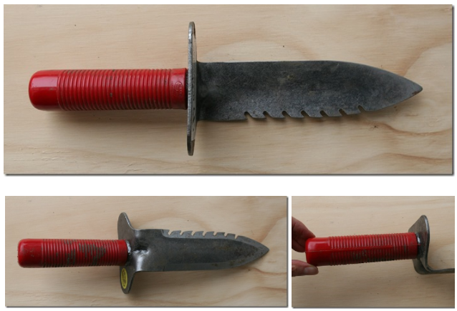
Hand Tools for Weed Management
Gardener’s Digging Tool
Notes:
There are different kinds of digging tools like this serrated trowel or soil knife that can help remove the plant by the root.

Slide 18
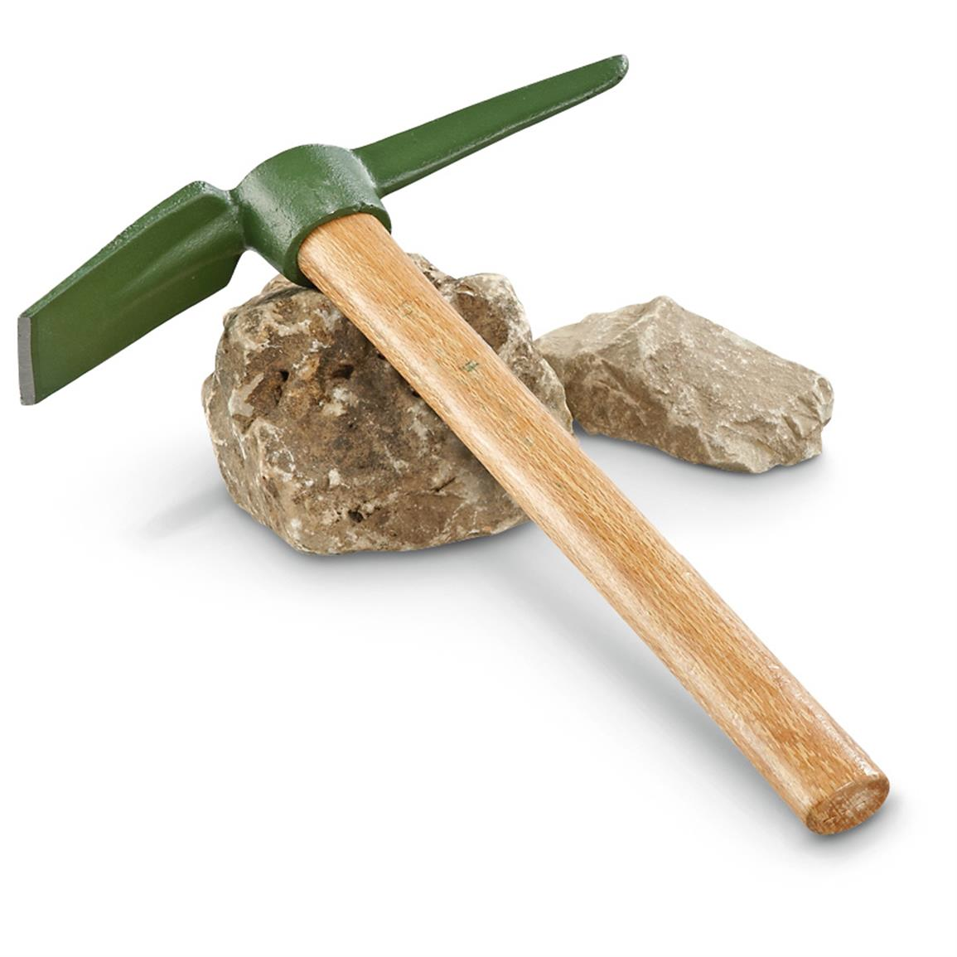
Hand Tools for Weed Management
Small Pick Mattock
Notes:
A pick mattock can be helpful for digging up larger weeds, or for loosening soil so that weeds can be pulled by hand.

Slide 19
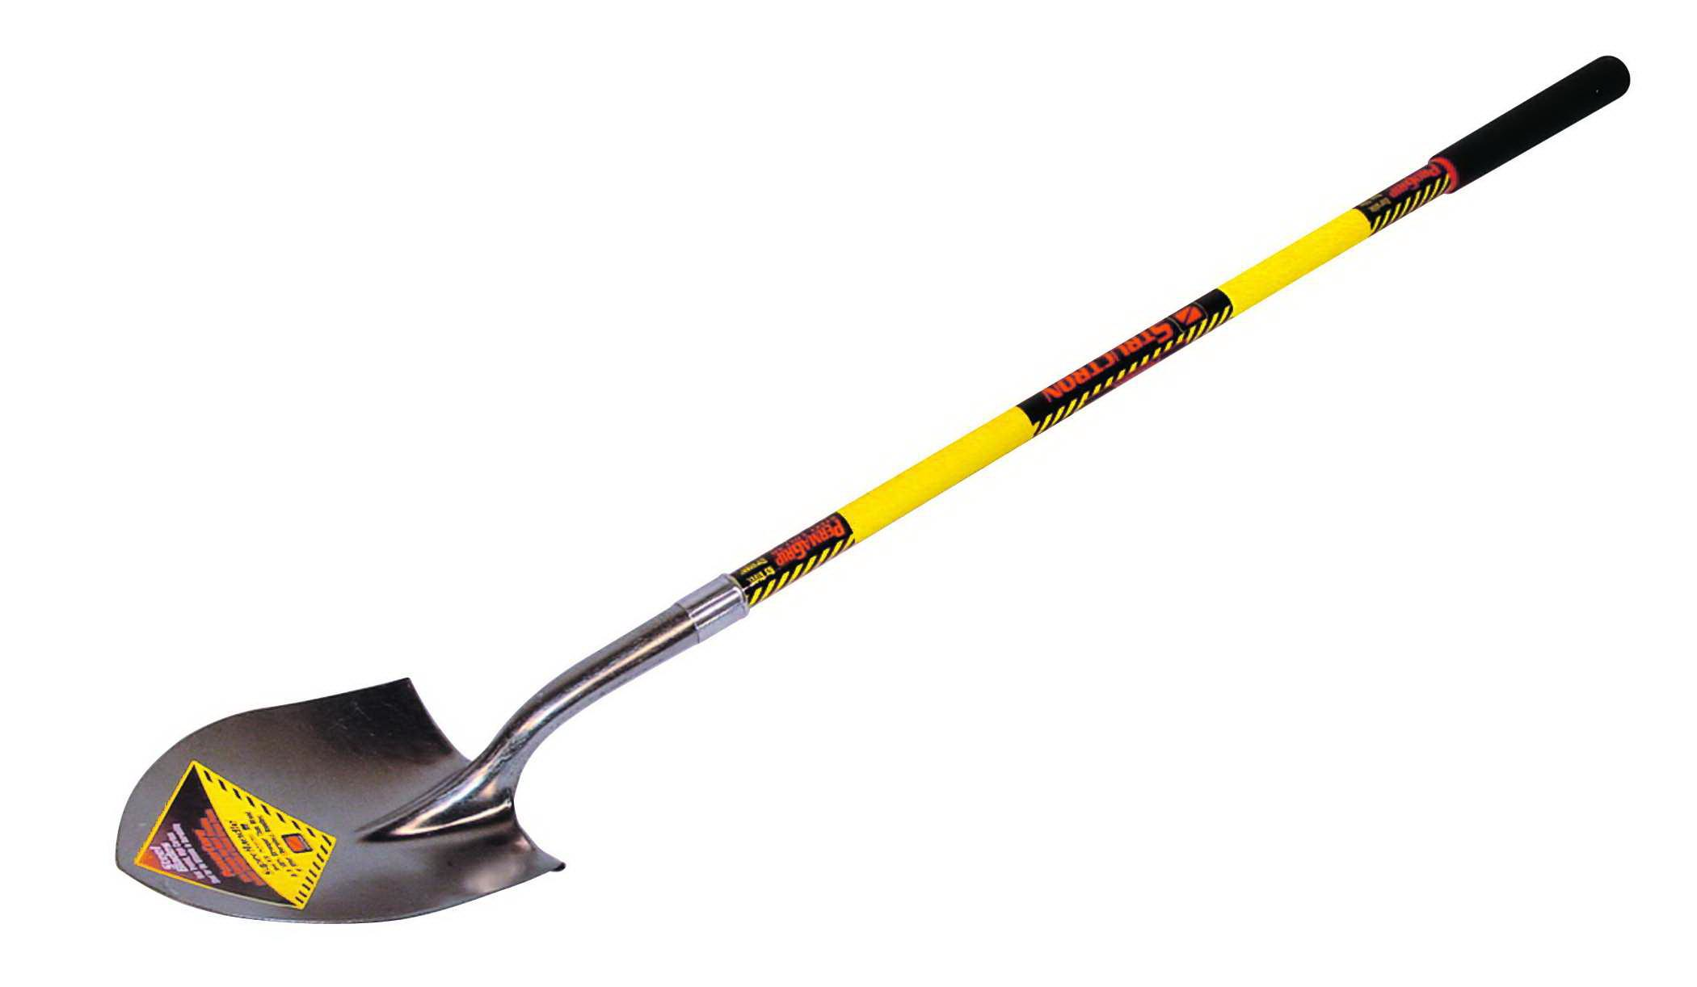
Hand Tools for Weed Management
Long handle, pointed shovel
Notes:
For very large weeds, especially weed trees, you may need a shovel to fully remove the root system.

Slide 20
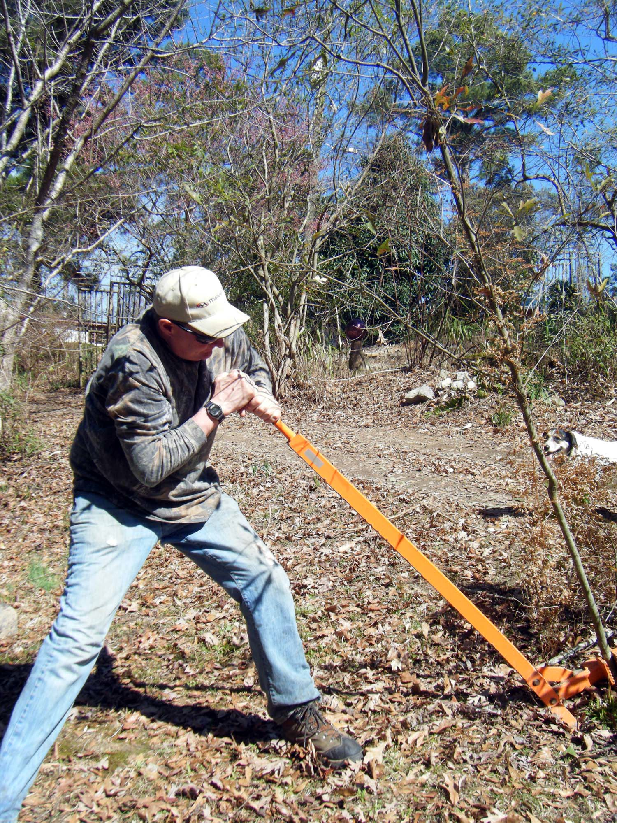
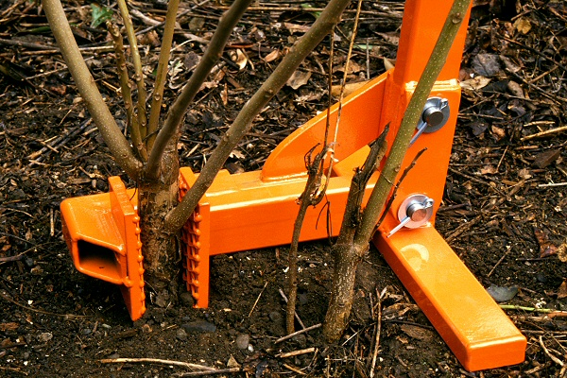
Hand Tools for Weed Management
Weed Wrench
Notes:
For the largest weeds, such as shrubs or small trees, there is a useful tool called a weed wrench, which works as a lever to grab these plants at the base and lift them out of the ground, roots and all.

Slide 21
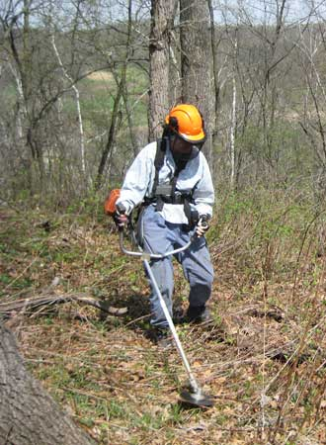
Mechanical Tools for Weed Management
String-trimming
  Useful for edges or large stands of plants (cut before weeds go to seed)
  Can be combined with herbicide treatment
Tilling and hoeing
  Till or hoe to a depth of 6-8 inches and reseed with target plant
Clip seed heads
Notes:
There are a number of different methods for controlling large or widespread weeds mechanically. String trimming or the use of a brush saw can allow you to cut the weed back to a manageable size prior to digging it out or treating it with herbicide.
Or, in some cases it may be possible to remove weeds simply by tilling the soil and replanting with a hardy native plant.
Where no other options are feasible, just removing the seed heads from annual weed plants in the fall can slow their spread by limiting their reproductive capacity.

Slide 22
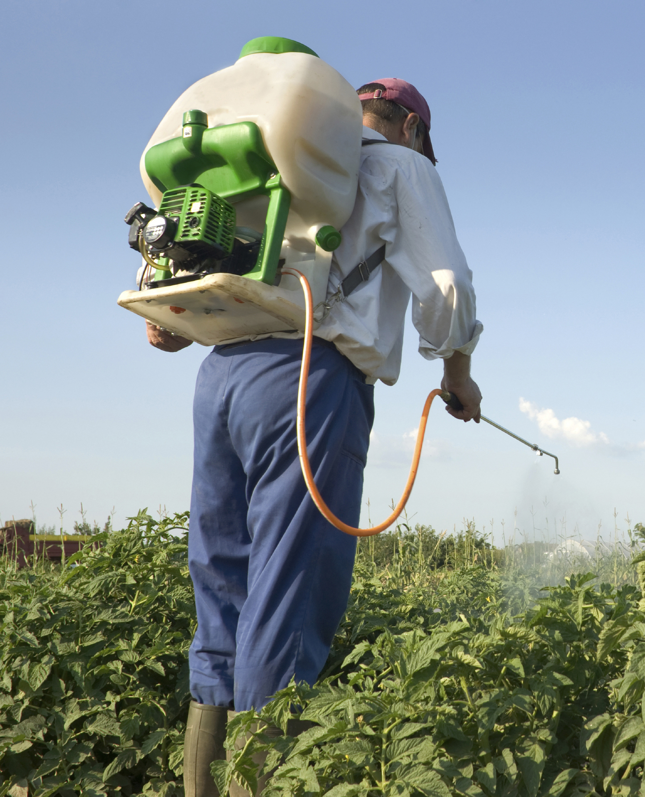
Chemical Weed Removal
When manual and mechanical methods are not effective, particularly for aggressive weeds
  Must be a state Certified Pesticide Applicator or Registered Technician
Herbicides targeted to plants’ growth patterns:
  Pre-emergent herbicides
  Selective broadleaf herbicides
  Blanket herbicides
Cost vs. benefit for large vs.small scale GSI programs
Must be performed in wind-free and dry weather
Notes:
Although non-chemical treatments are preferred, sometimes a weed infestation may be too big to manage without the use of chemicals. These chemicals, called herbicides, are useful for removing extremely aggressive or invasive plants. Certain herbicides may be targeted to specific types of plants.
Pre-emergent herbicide is used in the spring to prevent weed seeds from germinating.
Selective broad leaf herbicides are used in meadows to kill broad leafed weeds without killing the grasses that are meant to be there.
Blanket herbicides kill all plants they come in contact with and need to be used carefully.
In Pennsylvania, all herbicides used in a commercial setting need to be applied by a state-certified pesticide applicator. It is important to avoid windy or wet weather when applying these chemicals, to prevent them from affecting non-target plant species.

Slide 23
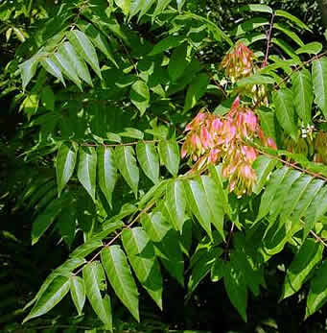
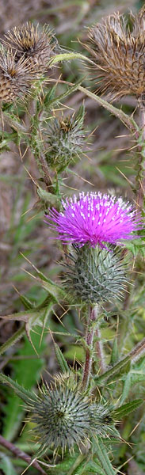
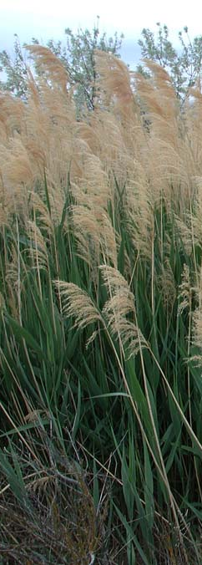
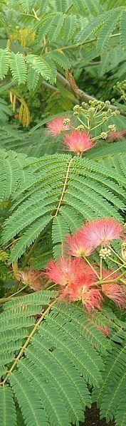
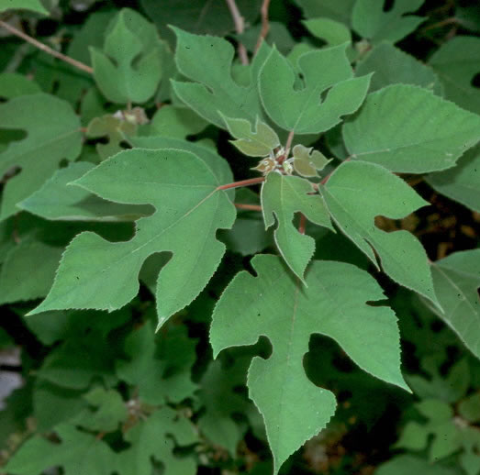
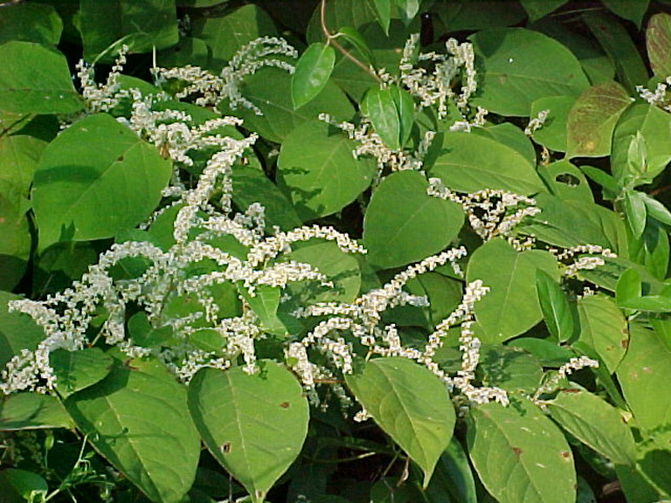
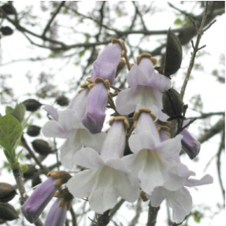
Weed Species Often Treated with Chemicals
Paper mulberry (Broussonetia papyrifera)
Tree of heaven (Ailanthus altissima)
Thistle (Cirsium sp. And Carduus sp.)
Japanese knotweed (Polygonum cuspidatum)
Phragmites (Phragmites australis)
Mimosa tree (Albizia julibrissin)
Princess tree (Paulownia tomentosa)
Notes:
Some common weeds may need to be treated with herbicides. Tree of heaven, Japanese knotweed, and invasive thistle are just a few that are difficult to control by other methods.

Slide 24
Integrated Weed Management
Combine manual, mechanical, and minimal chemical control measures (as needed) for optimal control
Minimize weed seed encroachment (i.e., nearby mowing & dumping)
Ensure that planting soil is weed-free (no untreated fill)
Minimize bare areas (mulching and replanting)
Stagger timing of control measures
Manual: consistent hand weeding throughout growing season
Mechanical: cut back in spring and fall
Chemical: immediately after flowering, or early spring for pre-emergent herbicides
Notes:
The process of synthesizing all of these potential management techniques according to the biology and needs of a landscape is known as integrated weed management. This involves developing a simple plan or schedule for which different weed control methods will be performed on various plant species.
For example, certain herbicides, like pre-emergents, need to be applied in the spring. In some cases the herbicide should not be applied until the plant has been cut back. Sometimes a second application may be needed to ensure that weed control has been achieved.
If weed removal leads to large bare areas, it may need to be timed to allow immediate replanting. All of these considerations can be documented in a weed management plan. By planning ahead, owners and managers can help crews be prepared with the right tools at the right times to ensure that plant communities stay healthy and well established.

Slide 25
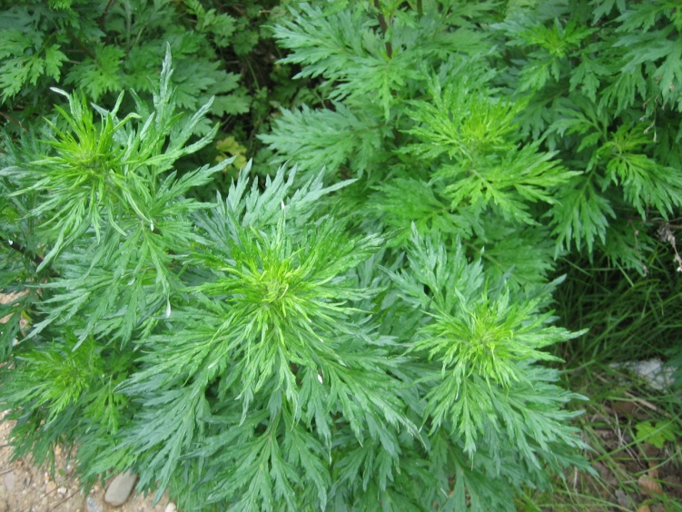
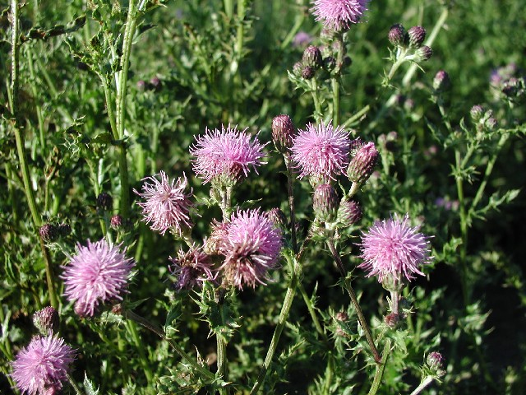
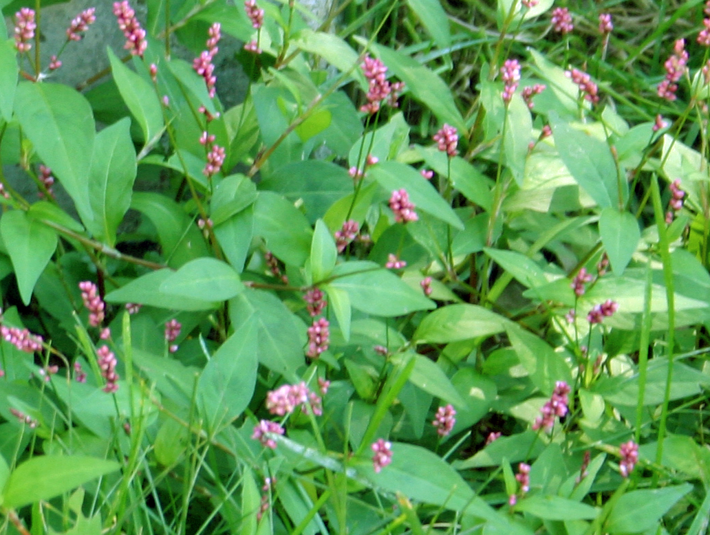
Non-Native Invasive Plants and
Common Weeds You May Find in Bioretention Areas
Notes:
Now that we’ve discussed why weed management is important and the major steps involved, let’s identify some common weeds that may be found in green infrastructure practices in southeast Pennsylvania. First I’ll focus on some common invasive plants, and then I’ll discuss aggressive native plants as well as others that are generally considered weeds for aesthetic reasons.

Slide 26
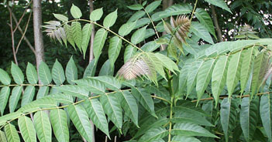
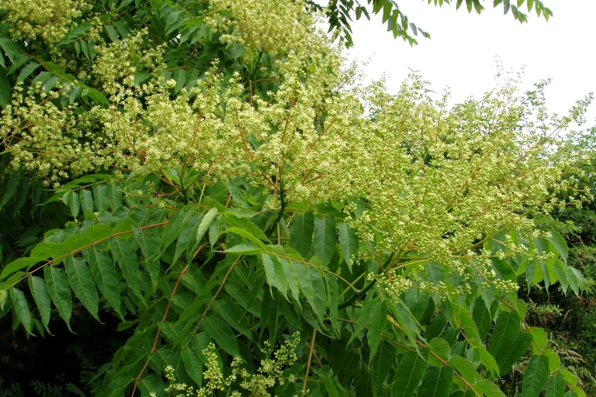
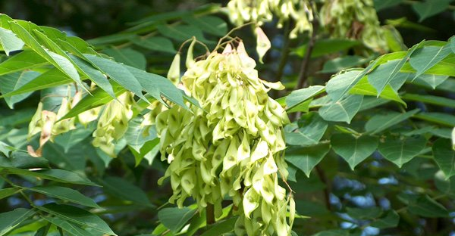
Botanical Latin name:
Common name:
Ailanthus altissima
Tree of Heaven
INVASIVE plant
Notes:
Ailanthus, or Tree of Heaven, is a very common invasive tree that’s found in urban areas and disturbed woodlands. It produces a high amount of seeds that appear in distinctive clumps as shown in the photo on the bottom right.
When it’s cut down to the stump, multiple suckers will grow up from the stump. The suckers will grow into a tree within a growing season, giving this tree its familiar name of “Tree of Heaven.”

Slide 27
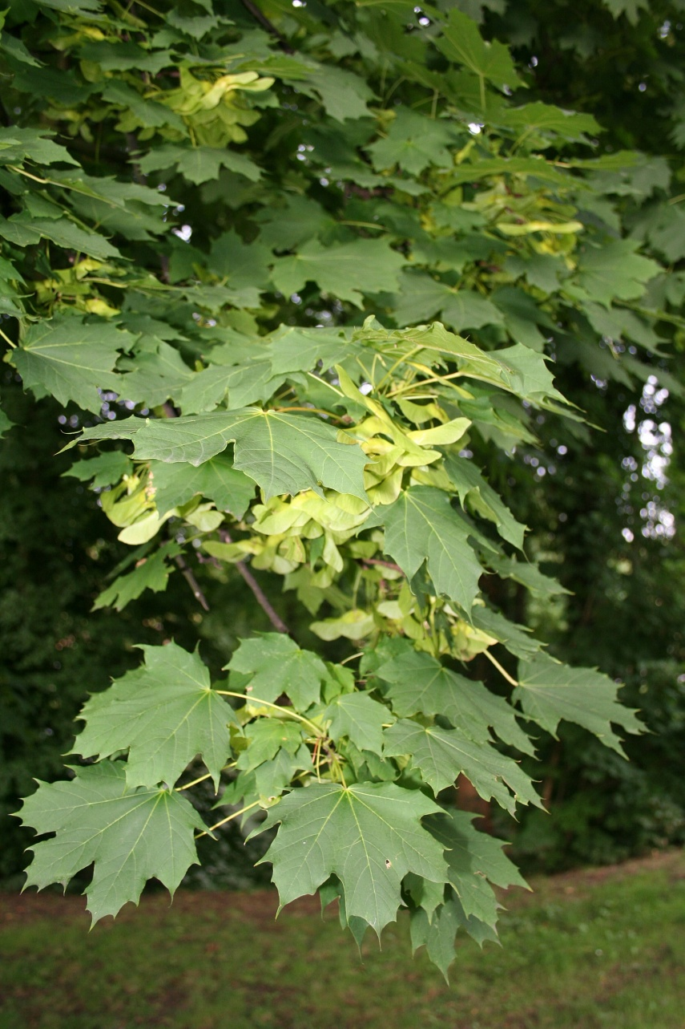
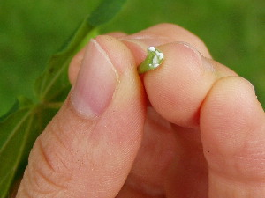
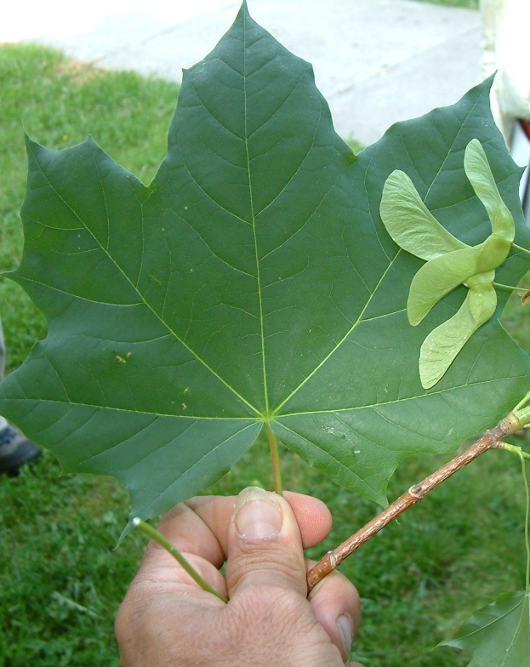
Botanical Latin name:
Common name:
Acer platanoides
Norway Maple
INVASIVE plant
Notes:
Norway maple is easy to identify by the white sap that’s visible when you break off a leaf or stem. Its seed pods are connected at opposite angles into a widely-spread winged samara. These features make it easy to distinguish from native maples that are commonly planted in rain gardens and have similar shaped leaves.

Slide 28
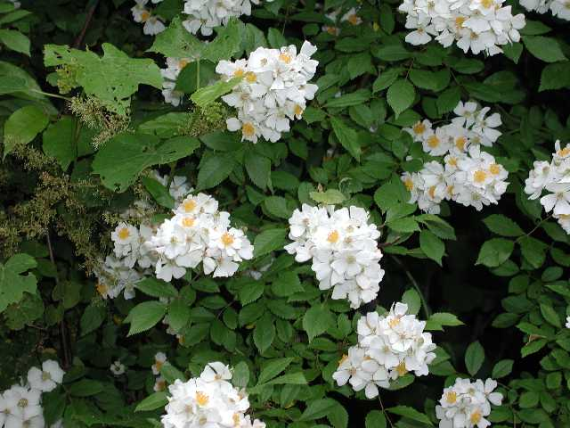
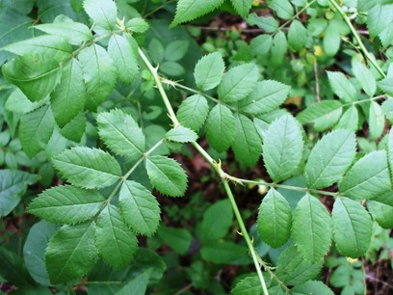


Botanical Latin name:
Common name:
Rosa multifora
Multiflora Rose
INVASIVE plant
Notes:
Multiflora rose looks similar to garden roses, but with a smaller leaf and flower.
For small infestations, you must cut and pull out entire root prior to this plant going to seed. Do not just cut the above-ground portion, because this will stimulate the growth of many more shoots.
For large infestations where the plant it has taken over a site -- Pesticide application is likely required.

Slide 29




Botanical Latin name:
Common name:
Lonicera japonica
Japanese Honeysuckle
INVASIVE plant
Notes:
Japanese honeysuckle is a common vine with opposite leaves and pale feathery flowers that are fragrant.
To remove this plant, cut and pull out the entire root before the plant goes to seed.

Slide 30




Botanical Latin name:
Common name:
Celastrus orbiculatus
Oriental Bittersweet
INVASIVE plant
Notes:
Oriental bittersweet is a very problematic vine in forests, where it can climb up and choke out even very large trees. It looks similar to honeysuckle in its early stages, but the leaves are rounder and offset rather than opposite. There are red berries with an orange shell in the fall. Herbicide is usually needed to fully eradicate an infestation.

Slide 31




Botanical Latin name:
Common name:
Polygonum perfoliatatum
Mile-A-Minute Vine
INVASIVE plant
Notes:
Mile-a-minute vine has a triangular leaf with small barbs along the stem. It grows very quickly, hence it’s name. It can usually be removed by hand pulling ( but you will want to use gloves). Be sure to pull it before the seeds are fully formed.

Slide 32


Botanical Latin name:
Common name:
Humulus japonicus Sieb. & Zucc. Japanese Hops
INVASIVE plant
Notes:
Japanese hops is a very aggressive annual vine that will quickly grow over trees and almost anything else. It has a distinctive prickly texture and a multi-lobed leaf. It must be treated immediately once it appears to prevent a serious invasion. Herbicides may be necessary.

Slide 33


Botanical Latin name:
Common name:
Microstegium vimineum (Trin.) A. Camus
Japanese stiltgrass
INVASIVE plant
Notes:
Stiltgrass is common in forested or semi-forested areas where there has been disturbance and there is some sunlight. It can be hand pulled for small infestations, or mowed or treated chemically for large infestations.

Slide 34



Botanical Latin name:
Common name:
Polygonum cuspidatum
Japanese knotweed
INVASIVE plant ALERT SUPERVISOR
Notes:
Japanese knotweed is most commonly found along streambanks or in other wet areas. It has large leaves that create dense shade around it and prevent other plants from growing. It is difficult to fully eliminate by hand because every shred of root must be removed, so it may require herbicide.

Slide 35




Botanical Latin name:
Common name:
Cirsium arvense
Canada Thistle
INVASIVE plant ALERT SUPERVISOR
Notes:
There are several native thistles, but the invasive Canadian thistle is the most common. It has a characteristic purple flower and spiny leaves. Hand pull the plants with gloves on, because it has small barbs on the stem. The flowers become downy white seeds that are easily carried by the wind, but are also favored by bird species – both causing wide spreading invasion.

Slide 36



Botanical Latin name:
Common name:
Ranunculus ficaria
Lesser Celandine
INVASIVE plant ALERT SUPERVISOR
Notes:
Lesser celandine, also known as fig buttercup, is an invasive perennial found in widespread carpets along forested floodplains and some upland areas. Lesser celandine has between 8 and 12 petals with a slightly darker center. Caution should be used when considering control measures because it strongly resembles several non-invasive native plants such as marsh marigold, which does not produce a dense monoculture carpet.

Slide 37



Botanical Latin name:
Common name:
Artimesia vulgaris
Mugwort
Hard to control weed
Notes:
This is a very common weed that can take over areas very quickly. It should be removed before it goes to seed. While not an invasive species, mugwort is difficult to control and is almost always managed as a weed.

Slide 38




Botanical Latin name:
Common name:
Cyperus esculentus
Yellow Nutsedge
Hard to control weed
Notes:
Nutsedge has a characteristic yellow tint to its leaves, and spreads aggressively by underground rhizomes. Like Mugwort, Nutsedge is a native plant with a very aggressive growth pattern that is usually removed from green infrastructure landscapes.

Slide 39



Botanical Latin name:
Common name:
Conyza canedansis
Horsetail
Common weeds
Notes:
Horsetail can grow to over 5 feet tall, although it’s usually much smaller. This photo shows horsetail at various life stages. It’s a very weedy looking plant and tends to grow much too tall for most landscaped beds. However, in a meadow setting this aggressive plant might not be considered a weed. The following weeds that will be shown are non-invasive and might be allowed to grow in more naturalistic settings.

Slide 40




Botanical Latin name:
Common name:
Senecio vulgaris
Common Groundsel
Common weeds
Notes:
Groundsel is a common weed with yellow flowers and dandelion-like seed heads. It’s easiest to hand pull it before it goes to seed.

Slide 41


Botanical Latin name:
Common name:
Convolvulus Arvensis. L
Field Bindweed
Common weeds
Notes:
Bindweed is a sun-loving vine with a leaf that looks similar to mile-a-minute, but without the spines. It has big white flowers. It should be hand pulled for small infestations and mowed for large infestations, such as in meadows.

Slide 42


Botanical Latin name:
Common name:
Polygonum pensylvanicum
Pennsylvania smartweed
Common weeds
Notes:
Pennsylvania smartweed is another native plant that is usually managed as a weed. It has distinctive pale pink flowers and leaves with arrow shaped markings. It is fairly easy manage with hand weeding.

Slide 43



Botanical Latin name:
Common name:
Smilax rotundifolia
Greenbriar
Common weeds
Notes:
Greenbrier is commonly found at woodland edges and in empty lots. This vine can be hand pulled in some cases.

Slide 44




Botanical Latin name:
Common name:
Morus alba
Mulberry
Common weeds
Notes:
Mulberry is commonly found in empty lots and roadsides. It has a dark berry that looks similar to a raspberry, and leaves that are fuzzy when they are new but become shiny at maturity. In most cases it’s possible to hand pull the whole plant when small. A weed wrench can be used if needed for larger plants.

Slide 45



Botanical Latin name:
Common name:
Vitus sp.
Wild grapevine
Common weeds
Notes:
Wild grapevine is a woodland and meadow vine that grows aggressively in many cases. Like many vines, it needs to be managed before it becomes widespread.

Slide 46
In This Presentation You Have Learned:
Why it is important to control invasive weeds in green stormwater infrastructure practices
What are the characteristics of invasive weeds
How to identify common invasive weeds
Best practices for invasive weed removal
Notes:
In this presentation you learned:
Why it’s important to control invasive weeds in green stormwater infrastructure practices
Characteristics of invasive weeds
How to identify Common invasive weeds, and
Best practices for invasive weed removal

Slide 47

Notes:
This concludes this presentation on weed management for green infrastructure. Thank you to our funder – the US Environmental Protection Agency Region III, and partners AKRF, Inc. and GreenTreks Network, which helped produce this series.

